Slide 1


ML Workshop - Day 3
Ekta Vayanan

Slide 2
CONTENTS :
Understanding some python libraries required for Machine Learning
Introduction to Machine Learning
What is Machine
Learning ?
How ML works?
Types of Machine Learning
AI vs ML vs Deep Learning
Applications of ML
ML job Trends, career opportunities and skills required

Slide 3
Machine Learning tools
PYTHON
SAS
R
But most commonly used language is python.
And some advantages of using python over any other language are:
1. Object oriented programming language.
2. Python is compatible with different platforms like mac, linux, raspberry pi.
3. It has a simple syntax.
4. Interpreter based language.

Slide 4
BASIC LIBRARIES IN PYTHON
Pandas
Matplotlib
Numpy
Seaborne

Slide 5

What is Machine Learning?
Machine learning is the ability of the machines, i.e the ability of the computers to learn and improve from their past experience or data, without being explicitly programmed.
PAST EXPERIENCE
PATTERN RECOGNITION
PREDICTION
Machine learning is the ability to learn from the input data and predict the future outcomes.

Slide 6
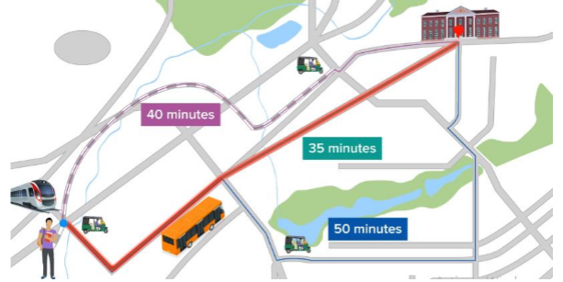
Example:
The student shown in the figure is going to his college for the first time and there are several routes to reach his destination. But for now he is not clear with the possible ways that he could go with to reach his college.
So on the first day he has no idea on how much time will it take and what could be his mode of travelling!
Different paths to reach his college-
From station ----metro (40 min) -----autorickshaw
Travelling by bus (35 min)
Travelling by autorickshaw (50 min)
So which according to you is the best possible way to reach the destination on time?

Slide 7

Some examples of Machine learning:
Facebook (Newsfeed) is the example of Machine Learning.
It works on the same pattern.
News shared with user
User commented, liked, or ignored
News Similar to news/commented on it
Past Experience
Pattern Recognition
Prediction
Similarly tagging friends on Facebook is also done with the help of ML i.e by facial recognition algorithm.

Slide 8
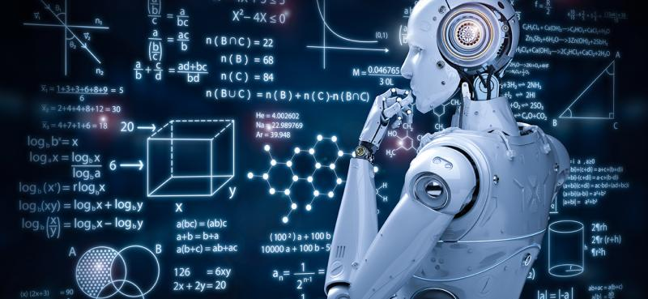
Data is the heart of Machine Learning
Data - Facts and statistics collected together for reference or analysis.
Raw information processed into meaningful information is basically Data.
Labelled data:
The data which contains a target variable or an output variable that answers a question of interest is called labelled variable.
Unlabelled Data: It contains information about something but does not have a predefined target variable.
Point to remember: The model learns from past labelled data, hence if the data is unlabelled we need to label the data so we get our independent and target variables.

Slide 9
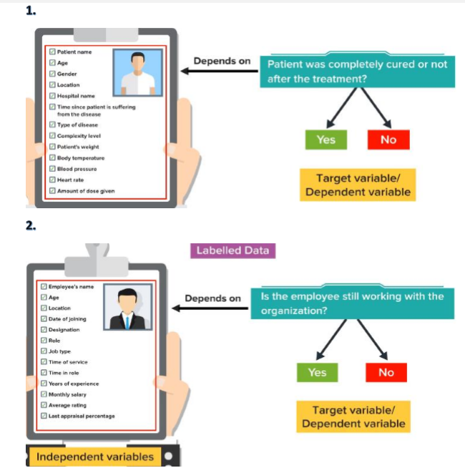
Labelled data

Slide 10
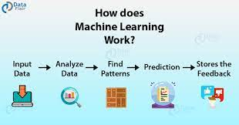
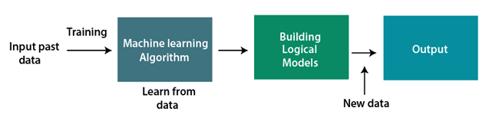
HOW DOES ML WORKS?

Slide 11
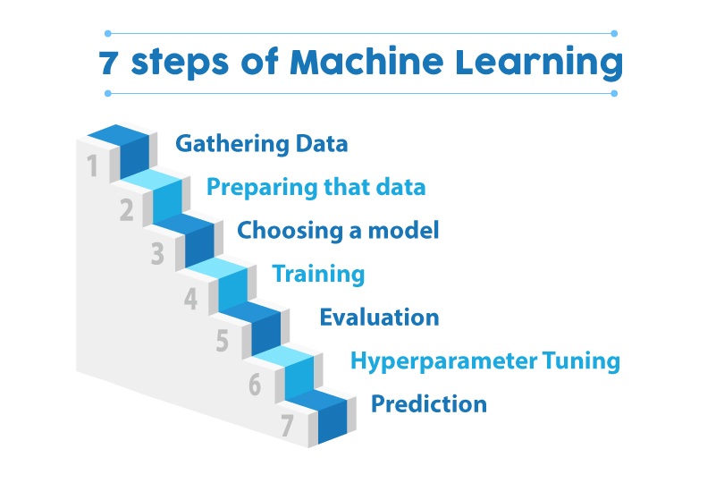
Steps to build ML model

Slide 12
SUPERVISED LEARNING
TYPES OF MACHINE LEARNING
UNSUPERVISED LEARNING
REINFORCEMENT LEARNING
SEMI - SUPERVISED LEARNING

Slide 13
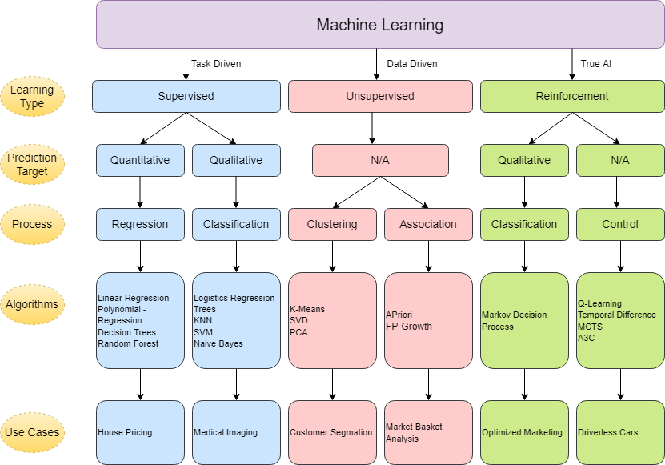

Slide 14
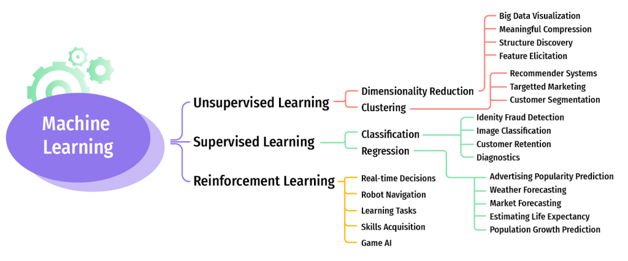

Slide 15
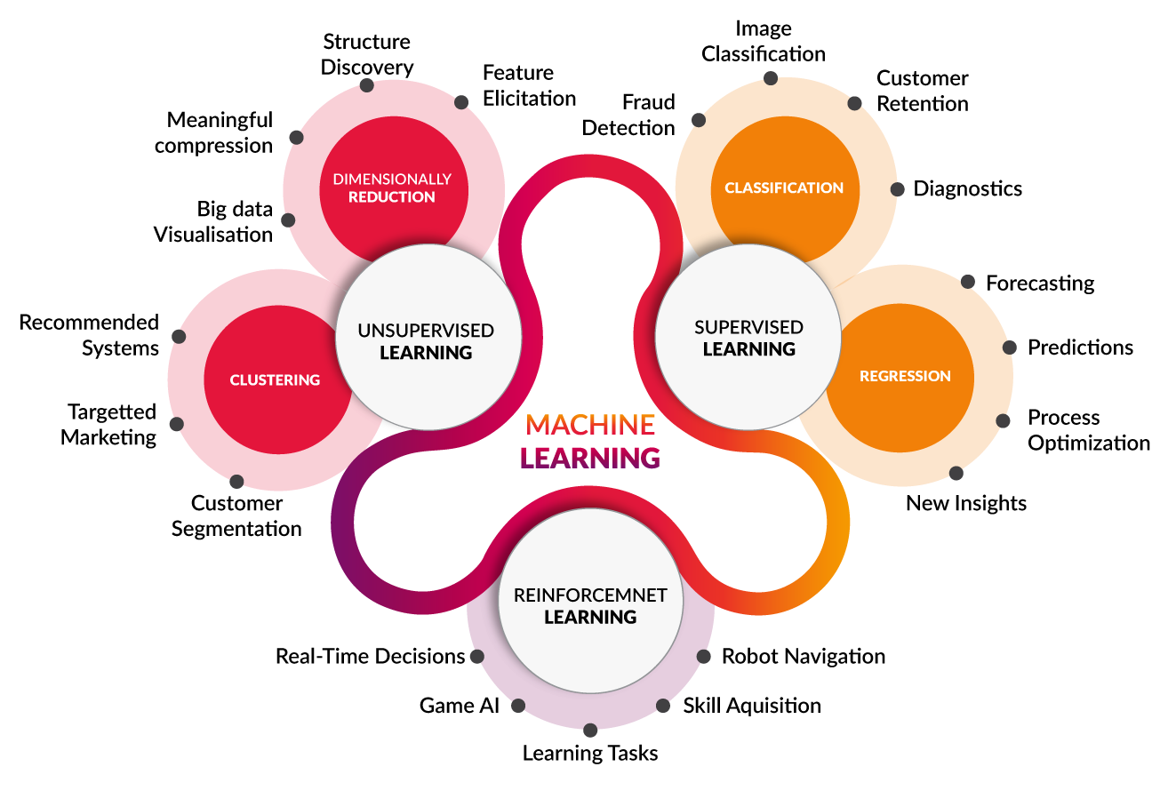

Slide 16
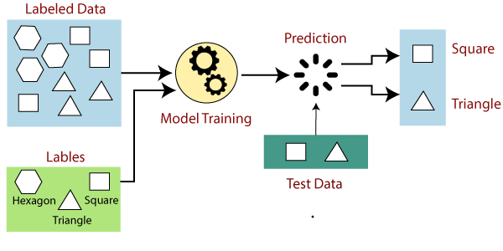
Supervised learning

Slide 17
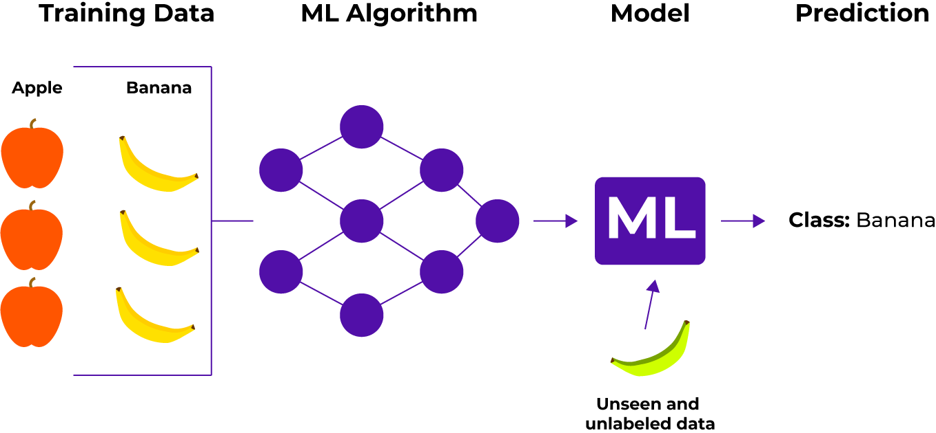

Slide 18
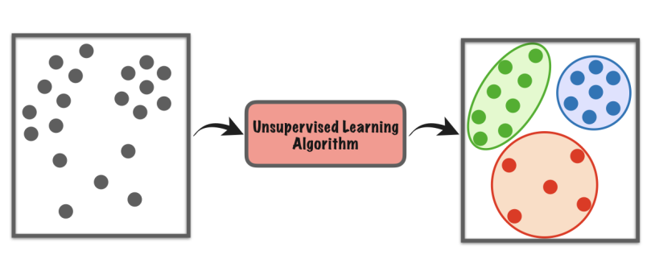
Unsupervised learning

Slide 19
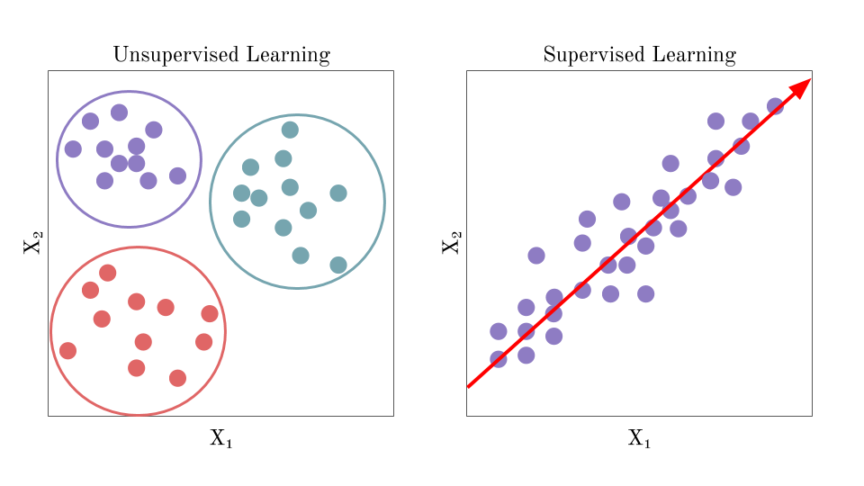

Slide 20
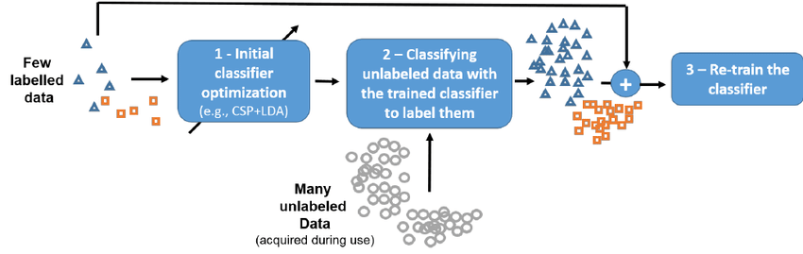
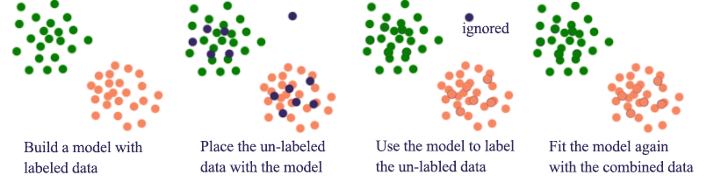
Semi – supervised learning

Slide 21
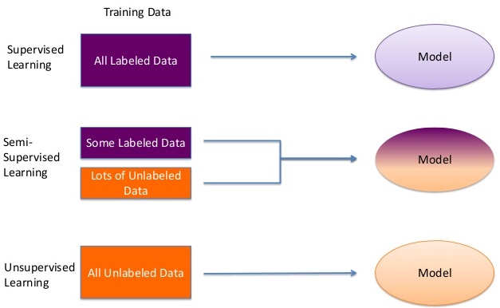

Slide 22
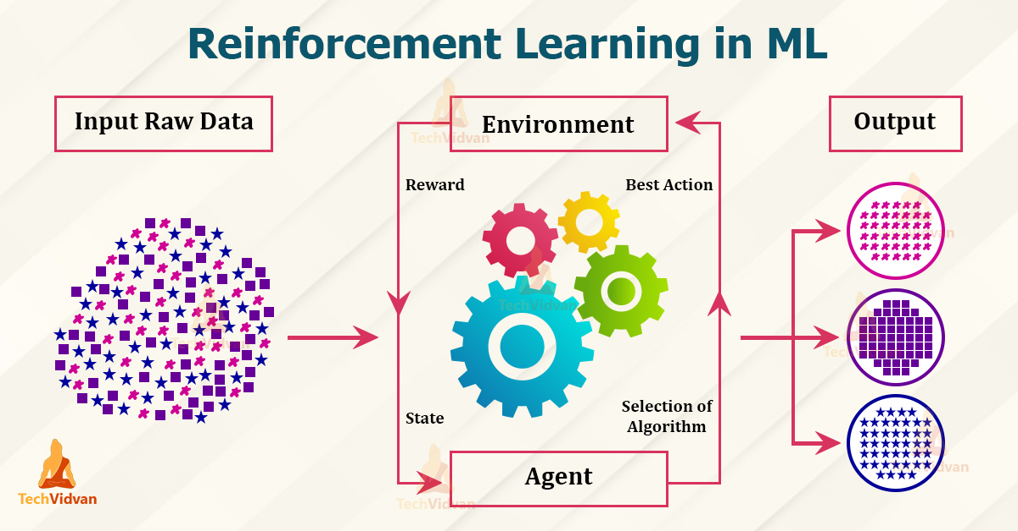

Slide 23
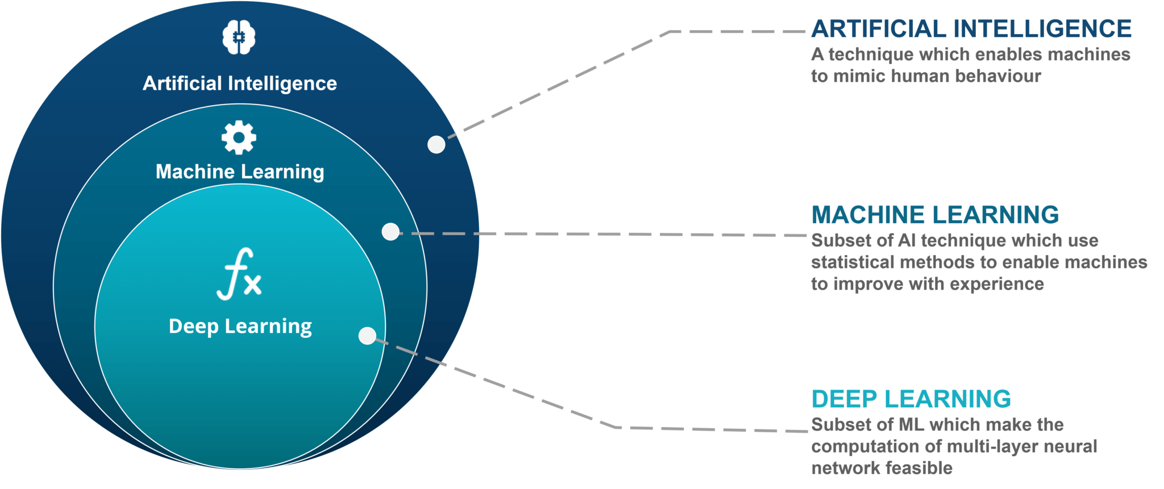
AI vs ML vs DL

Slide 24
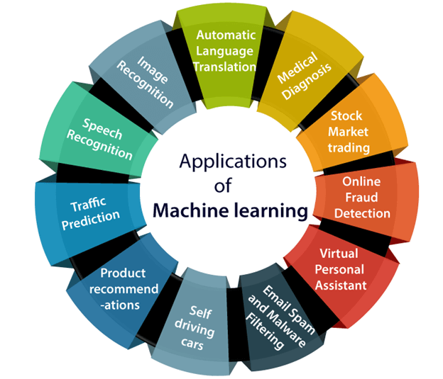
Applications of ML:

Slide 25
Job trends and career opportunity/ skills required to work in this field:-
AI and machine learning jobs have jumped by almost 75 percent over the past four years and are poised to keep growing. Pursuing a machine learning job is a solid choice for a high-paying career that will be in demand for decades.
1. Machine Learning Engineer
2. Data Scientist
3. Human-Centered Machine Learning Designer
4. Computational Linguist
5. Software Developer

Slide 26
Skills required to get in this field:
1. Programming
2. Probability & statistics
3. Data modelling
4. Machine learning algorithms
5. System design
6. Calculus & algebra
7. Database management
8. Computer science
9. Data structures
10.Analytical skills

